Slide 1
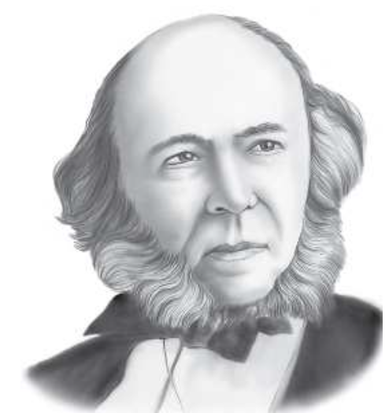
Social Darwinism
Principles of Sociology (1877).
‘The science of sociology has to give an account of (how) successive generations of units are produced, reared and fitted to co-operation’
The family, politics, religion, social control, and industry.
The sociological study of associations, communities, division of labour, social stratification, the sociology of knowledge and of science, art and aesthetics. The whole society as unit of analysis.
Herbert Spencer (1820-1903)
‘We have to deal with facts of structure and function displayed by societies in general dissociated, so far as may be, from special facts due to special circumstances’.
Societies are evolving from a lower form to higher forms. As generations pass, a society’s most capable and intelligent members (the fittest) survive, while the less capable die out.

Slide 2
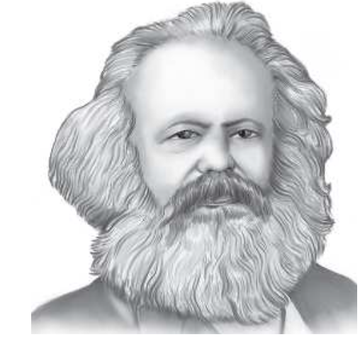
Class Conflict
Considered one of the greatest modern thinkers.
Gave birth to political philosophy of communism.
Social change through revolution.
The engine of human history is class conflict (bourgeoisie and proletariat)
Bourgeoisie (the capitalists, those who own the means of production- money, land, factories, and machines).
Proletariat (the exploited workers, who do not own the means of production).
Karl Marx (1818-1883)
Conflict theory: the relationships of production and exchange are the basis for all other relationships.

Slide 3
Weber’s Key Concepts
Verstehen (empathetic understanding)
Interpretative understanding
Intellectual understanding of social action over emotional understanding
Attempt to understand both intention and context of human action.
Causality
To study the causes of social phenomena.
The probability that an event will be followed or accompanied by another event.
Looking at the reasons for, and the meaning of historical changes.
Emphasis on the understanding of the human conduct.

Slide 4
Weber’s Key Concepts
Ideal Type
‘Conceptual pattern which brings together certain relationship and historical events into a complex whole whose purpose is to describe historical societies by comparing their internal and external characteristics’.
Mental constructs or concepts, like a model and as a methodological tool to understand and analyse social reality.
Ideal types are concepts formulated on the basis of facts collected carefully and analytically for empirical research.

Slide 5
Weber’s Key Concepts
Bureaucracy
‘A type of organization based on written rules, contracts and a hierarchy of positions that is widely adopted in modern industrial societies’.
Ideal type of Bureaucracy
High degree of specialization and a clearly defined division of labour.
Hierarchical structure of authority with clearly circumscribed areas of command and responsibility,
Establishment of a formal body of rules to govern the operation of the organisation and administration based on written documents,

Slide 6
Weber’s Key Concepts
Ideal type of Bureaucracy
Impersonal relationships between organisational members and the clients,
Recruitment of personnel based on ability and technical knowledge,
Long term employment, promotion on the basis of seniority and merit,
Fixed salary and the separation of private and official income.
Authority
Traditional authority: based upon the belief in the sanctity of age- old customs and rules.
Rational authority: maintained by laws, decrees, regulations.
Charismatic authority: characterised by exceptional virtue possessed by or attributed to the leader by those who follow the leader, have confidence in the leader and are devoted to the leader.

Slide 7
Weber’s Key Concepts
Rationality
Ideas and behaviour which are logically coherent and consistent and amenable to empirical knowledge.
Rationalization is a process whereby rationality is applied to various aspect and activities of life. A shift towards actions based on reasons, calculability, predictability and efficiency.
The key to understand modern society is to be found in its rational features and rationalizing forces.
Rationalization is the product of scientific specialization and technological differentiation.
Striving for perfection, as an ingenious refinement of the conduct of life and the attainment of mastery over external world.

Slide 8
Weber’s Key Concepts
Development of Rational Capitalism in Modern Society
Private ownership of all physical means of production,
Freedom of the market,
Mechanisation,
Written law and administration,
Free labour and commercialisation of economic life.
Capitalism was not the product of revolutionary change, nor was it likely to give way to communism in the future.
The future of the working class lay in the development, not the ending, of capitalism.
Relentlessly advancing machine based on the principle of rationalization, DoL and fixed capital.

Slide 9
Weber’s Key Concepts
Religion
Refers to a set of ideas and beliefs about the supernatural and its impact on the lives of human beings.
Religious beliefs provide supernatural answers to difficult questions: why is it that loved one dies? Why does a good man/woman suffer and an evil one prospers? Why do natural calamities happen?
Protestantism
A 16th century religious doctrine espoused by Martin Luther and John Calvin.
Came into being during the period called reformation in Europe.
Catholic Church had become too immersed in doctrines and ritual and lost touch with the common people. Greed, corruption and vice had gripped the church.
The Protestant sects that sprang up all over Europe tried to recapture the lost spirit of the Church.

Slide 10
Weber’s Key Concepts
Calvinism
A branch of Protestants which began with theological teaching of John Calvin.
He severed ties with the Catholic church in 1534.
Salvation theology:- doctrine of predestination.
Features of Calvinism
Image of God
Doctrine of pre-destination
Worldly asceticism
The notion of ‘calling’.

Slide 11
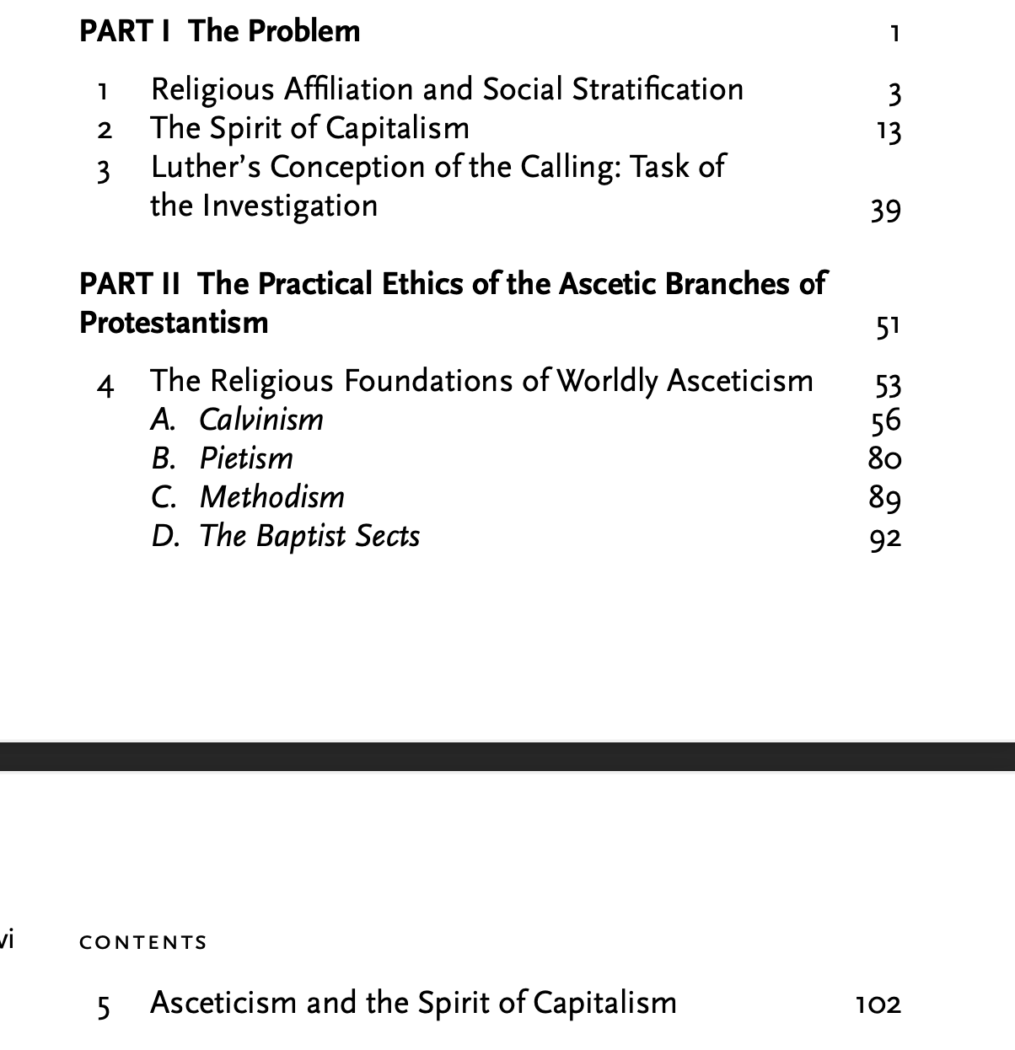

Slide 12
The Protestant Ethic and the Spirit of Capitalism
Weber’s key argument: modern-day capitalist attitudes toward work and money have their basis in the religious doctrines of various Protestant sects of Christianity.
Rational economic calculation is the key to capitalist spirit.
“The fact that business leaders and owners of capital, as well as the higher grades of skilled labour, and even more the higher technically and commercially trained personnel of modern enterprises, are overwhelmingly Protestant” (p. 3).

Slide 13
The Protestant Ethic and the Spirit of Capitalism
Principle features of the spirit of modern capitalism
“the acquisition of more and more money, combined with the strict avoidance of all spontaneous enjoyment ... is thought of so purely as an end in itself, that vis-à-vis the happiness of, or utility to, the particular individual, it appears as quite transcendental and wholly irrational. Man is dominated by acquisition as the purpose of his life; acquisition is no longer a means to the end of satisfying his material needs. This reversal of what we might call the' natural' situation, completely senseless from an unprejudiced standpoint, is evidently as definitely a leading principle of capitalism as it is foreign to all peoples not under capitalistic influence”.

Slide 14
The Protestant Ethic and the Spirit of Capitalism
Dominant characteristic of the modern capitalist economy
“Rationalised on the basis of rigorous calculation, directed with foresight and caution towards the economic success which is sought in sharp contrast to the hand-to-mouth existence of the peasant, and to the privileged traditionalism of the guild craftsman and of the adventurers' capitalism, oriented to the exploitation of political opportunities and irrational speculation”.

Slide 15
The Protestant Ethic and the Spirit of Capitalism
Four Streams of Ascetic Protestantism
Calvinism
Methodism
Pietism
Baptist sects.

Slide 16
The Protestant Ethic and the Spirit of Capitalism
Three tenets of Calvinism
The doctrine that the universe is created to further the greater glory of God, and only has meaning in relation to God's purposes. ‘God does not exist for men, but men for the sake of God.’
The principle that the motives of the Almighty are beyond human comprehension.
The belief in predestination: only a small number of men are chosen to achieve eternal grace.

Slide 17
The Protestant Ethic and the Spirit of Capitalism
Five Key arguments
Remarkable congruence between Protestantism and the development of modem capitalism’ in countries where Protestantism had taken hold.
Demonstrate how Protestant religious maxims had placed ‘unambiguous stamp on the economic organization’ of Western capitalism.
The impact of John Calvin’s religious doctrine on what Weber believed to be specific form of rational conduct leading to restraint, order and the rejection of luxury and excess in economic matters.

Slide 18
The Protestant Ethic and the Spirit of Capitalism
Five Key arguments
Rational economic conduct in the form of restraint was not simply an inconsequential outcome of Calvin’s religious doctrine, but was rather the result of a series of ‘practical psychological motives’ and ethical religious precepts that became incentives for life regulation in which religion fused itself to economic conduct in the world with the aim of controlling material reality and its temptations.
In response to Calvin’s predestination doctrine, a certain type of Protestant religiosity produced a ‘psychological vehicle’ that since the sixteenth century tended to create a form of conduct compatible with church doctrine (Ken Morrison, 1995).

Slide 19
Weber on Confucianism in China
Ancient China had a well-developed economy (trade, commerce, finance and manufacture were quite advanced)
But why Western style of capitalism did not develop in China?

Slide 20
Confucianism Ethic
Belief in the order of the Universe, the cosmos.
Man should aim at being in harmony with nature and the cosmos.
Behaviour is to be guided by tradition. All wisdom lies in the past.
Family and kin ties and obligations were never to be neglected.
The stress on harmony, traditionalism and family obligations are quite contradictory to the relentless pursuit of profit for its own sake.

Slide 21
Hinduism in India
Weber attribute negative attitude towards developing rational capitalism within the ethos of Hinduism.
Modern capitalism unlikely in a caste-based society nor could capitalism be imported from West to flourish in India.
Ideas like ‘Karma’, ‘dharma’, ‘punarjanma’ not suitable for development of capitalism.
Ideal like ‘moksha’, ‘vasana’, ‘may-jaal’ de-emphasised material world.
Mere material conditions like finance, trade and technology are not enough to promote capitalism.

Slide 22
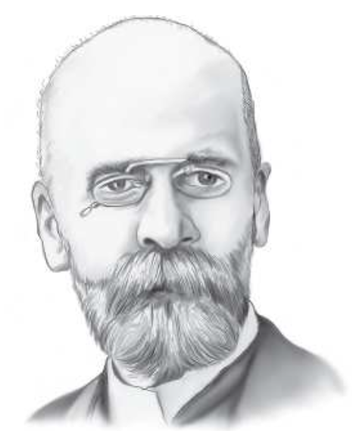
Emile Durkheim
He was born on April 15, 1858 in Epinal, France.
Grew up in a Jewish family (his father was a rabbi).
Joined Ecole Normale Superieure college in 1879.
In 1887 joined as Professor in University of Bordeaux.
Established sociology as distinct discipline in 1895 at Bordeaux
First sociology journal in 1898 (L’Annee Sociologique).
Emile Durkheim (1858-1917)
1893: Division of Labour in Society
1895: The Rules of Sociological Method
1897: Suicide
1912: The Elementary Form of Religious Life.

Slide 23
What ideas influences Durkheim’s Mind on Society?
Comte’s idea of positivism
Applying scientific method found in the natural sciences to the social sciences (speculative science). It stressed for empirical facts and induce general laws.
Social Realism
Social realities exist in the outer world and that these realities are independent of the individual’s perception of them.
Functionalism/organic analogy
The various parts of society are interrelated and work together to maintain a stable whole.

Slide 24
The Rules of Sociological Method (1895)
Outline the nature of sociological subject matter (study of social facts)
To establish the existence of social realities outside the individual,
The nature of social subject matter (social facts) and identifying power of external coercion which exercise over individuals.
Outline the rules to be use in observing social subject matter
Outline a system for classifying societies (social morphology).

Slide 25
What is a Social Fact?
“Before beginning the search for the method appropriate to the study of social facts it is important to know what are the facts termed 'social’. The question is all the more necessary because the term is used without much precision.”
“When I perform my duties as a brother, a husband or a citizen and carry out the commitments I have entered into, I fulfil obligations which are defined in law and custom and which are external to myself and my actions”.
“Even when they conform to my own sentiments and when I feel their reality within me, that reality does not cease to be objective, for it is not I who have prescribed these duties; I have received them through education”.

Slide 26
1) Social Facts are External to the Individual?
“The believer has discovered from birth, ready fashioned, the beliefs and practices of his religious life; if they existed before he did, it follows that they exist outside him. The system of signs that I employ to express my thoughts, the monetary system I use to pay my debts, the credit instruments I utilise in my commercial relationships, the practices I follow in my profession, etc., all function independently of the use I make of them. Considering in turn each member of society, the foregoing remarks can be repeated for each single one of them”.

Slide 27
Social Facts are Coercive
“Not only are these types of behaviour and thinking external to the individual, but they are endued with a compelling and coercive power by virtue of which, whether he wishes it or not, they impose themselves upon him.”.
Resistance
“None the less it is intrinsically a characteristic of these facts; the proof of this is that it asserts itself as soon as I try to resist. If I attempt to violate the rules of law they react against me so as to forestall my action, if there is still time. Alternatively, they annul it or make my action conform to the norm if it is already accomplished but capable of being reversed; or they cause me to pay the penalty for it if it is irreparable.”

Slide 28
Social Facts are General
“It may be objected that a phenomenon can only be collective if it is common to all the members of society, or at the very least to a majority, and consequently, if it is general. This is doubtless the case, but if it is general it is because it is collective (that is, more or less obligatory);”
Social Facts Definition
Social Facts : “Consist of manners of acting, thinking and feeling external to the individual, which are invested with a coercive power by virtue of which they exercise control over him.”

Slide 29
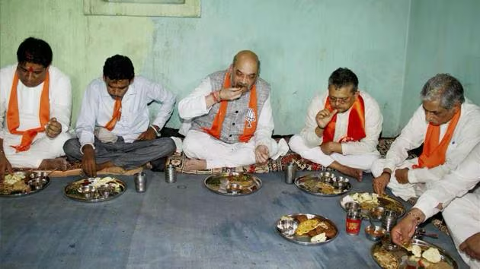
Characteristics of Social Facts
External to individual
Coercive
General
Photo courtesy: Hindustan Times

Slide 30
How to Observe Social Facts?
“The first and most basic rule is to consider social facts as things.”
Social facts are to be treated as if they were things as opposed to simple ideas.
Social facts as distinct in themselves and separate from consciously formed impression of mind.
To examine as things external to the individuals
Avoid all preconceptions.
Formulate the concepts precisely.
Time and Context of Social Facts

Slide 31
‘Incidents of suicide by students from marginalised communities are becoming common, these numbers are not just a statistic they are stories sometimes of centuries of struggle.’
Chief Justice of India Justice DY Chandrachud

Slide 32


Slide 33
Suicide (Durkheim, 1897)
Why Durkheim finds it interesting to study suicide?
Growing social problem in Europe,
Many believes suicide due to development of industrial society,
Advance individualism,
Individual autonomy and political freedom
Social fragmentation and egoistic forces replaces collective authority in society
What are the social factors that cause suicide?
Sample size: 26000 suicide (data from 1841-1873 from France, Denmark, England, Austria and Germany).
Shift from psychological to social theory of suicide.

Slide 34
Suicide
Durkheim questioned psychological response to suicide (mental illness, depression, sudden tragedy, reversal of fortune, bankruptcy etc.).
Social cause of suicide precede individual cause and analyse social framework of society.
Social attachment between individual and wider society
Link individuals to social group outside themselves.
‘People take their own lives not because of the psychological states of depression or mental illness but rather because of the social forces acting on them which reduces their attachments to the wider society to the point that they become isolated, separated and autonomous from others’.

Slide 35
Suicide
Social suicide rate
No. of suicidal deaths in given society and the extent to which the suicide rates themselves could be look upon as establishing a pattern of suicide for a given society.
Social Integration
The extent to which individuals are linked to and feel allegiance for social groups to which they attached.
It creates social duties
Creates links of dependency and ties of social obligation
Check against excessive social isolation and individualism.

Slide 36
Egoistic Suicide
Egoistic suicide results from the absence of social integration and a weakening of the bonds which attach individuals to groups outside themselves.
It occurs when the integrative mechanisms attaching individuals to the family, religious and political group form gaps in the links connecting individuals to society so that individuals retreat to themselves.
Social attachment to the religious group, the family group and the national political group have a moderating effect on egoistic suicide (Morrison, 1995).

Slide 37
Altruistic Suicide
The polar opposite of egoistic suicide.
Too much social integration rather than too little.
Those social custom that placed high degree of social honour on individuals who take their own lives in the name of social purposes greater than themselves.
The suicide of older men threatened with severe illness;
The suicide of women on the death bed of their husbands; and
The suicide of followers on the death of their chiefs.
The bonds between the individual and society are developed to such an extent that the individual acquires an aptitude for the renunciation of life.
Individual takes their own life by reason of a ‘social duty’ that is imposed upon them externally by society.

Slide 38
Anomic Suicide
Suicide that relates to the regulatory functions of society, and this has two polar extremes represented by anomic and fatalistic suicide.
Anomie refer to the decline that takes place in the regulatory functions of society and social institutions during industrial development when the capacity of society to set the necessary level of social restraint begins to weaken.
The shift in the regulatory mechanisms of society which occurs precisely during periods of economic hardship or prosperity.
The state that results from the weakening of the powers of society which regulate social equilibrium by setting the acceptable level of social restraint.
Framework which explains suicide by looking at the changes in the regulatory mechanism of society.

Slide 39
Fatalistic Suicide
The opposite pole of suicide resulting from adjustments in the regulatory mechanisms of society.
Fatalism signifies a form of suicide which Durkheim believed occurred because of an excess of social regulation.
Anomie refers to the absence of regulation, fatalistic suicide occurs because of an excessive degree of regulation and an overly developed system of control over the individual
Durkheim cited as an example the suicide of slaves who, seeing no alternative to life except enslavement under a master, take their own life (Morrison 1997).

Slide 40
The Division of Labour in Society (1893)
Distinction between the ‘social division of labour’ and the ‘economic division of labour.’
The nature of the social links connecting individuals to society and the social bonds which connect individuals to each other.
Specific origin of the social links and bonds in order to see in what way they were related to the overall system of social cohesion in society,
The extent to which the system of social links change as the structure of society became more complex and subject to changes in the division of labour.
Why do individuals, while becoming more autonomous, depend more upon society?
How can they be at once more individual and yet more cohesive?’

Slide 41
The Division of Labour in Society (1893)
Social Division of Labour (DoL)
The process of dividing up labour among individuals in a group so that the main economic and domestic tasks are performed by different people for the purposes of the collective maintenance of society.
DoL result of a social process taking place within the structure of society rather than the result of the private choices of individuals or the result of organic traits that emerged during evolution
The social links and bonds which develop during the process that takes place in societies when many individuals enter into cooperation for purposes of carrying out joint economic and domestic tasks.

Slide 42
The Division of Labour in Society (1893)
Social Division of Labour (DoL)
The social division of labour led to the formation of what he called social ‘links and bonds’ that attach individuals to the wider society and to each other by linking actual cooperators together.
These links and bonds formed a system of attachments to society which Durkheim referred to as social solidarity,.
The overall unity of the society is referred as social solidarity.
The term ‘solidarity’ was used to identify a system of social relations linking individuals to each other and to society as a whole.

Slide 43
The Division of Labour in Society (1893)
Mechanical Solidarity
The a homogeneous population which is small and isolated;
A division of labor based on social cooperation that coordinates economic, political and religious activities so that people live commonly and cooperate collectively;
A system of social institutions in which religion and the family system are dominant and function as the major source of social cohesion in that they link individuals to each other by obligation;
A system of religious beliefs which are uniformly diffused throughout the society, creating uniformity in attitudes and actions that act on them by unifying their minds and by exerting an emotional hold over them;

Slide 44
The Division of Labour in Society (1893)
Mechanical Solidarity
A low degree of individual autonomy in which private life never develops and the individual is not a distinct social unit;
A system of penal law based on repressive sanctions which punish individual transgressions swiftly and violently, serving the function of reaffirming core beliefs and values when sacred social rules have been violated;
A social organization in which the individual’s place in society is determined by kinship and family organization;
A system of social cohesion which produces a high degree of consistency in social practices and beliefs and in individual attitudes and actions;

Slide 45
The Division of Labour in Society (1893)
Mechanical Solidarity
A state in which individualism is at its lowest point of development and where the individual does not appear as distinct from the group; and
A system of social links and bonds between individuals based on custom, obligation and social duties that reflect a dependency on society

Slide 46
The Division of Labour in Society (1893)
Organic Solidarity
Large populations spread over broader geographic areas;
An increased complexity of division of labor leading to specialized economic function in which individuals are more reliant on others to perform economic functions which they cannot perform themselves;
A system of social relations in which individuals are linked to each other by contract rather than by sentiment, obligation or explicit social duties;
A system in which individuals obtain their place in society by occupation rather than by kinship affiliation within the tribal segment;

Slide 47
The Division of Labour in Society (1893)
Organic Solidarity
An increased individual autonomy based on a system of laws recognizing rights and individual freedoms;
The development of contract law based on restitutive rather than repressive sanctions in which judicial rules redress social wrongs by restoring things to their original state.

Slide 48
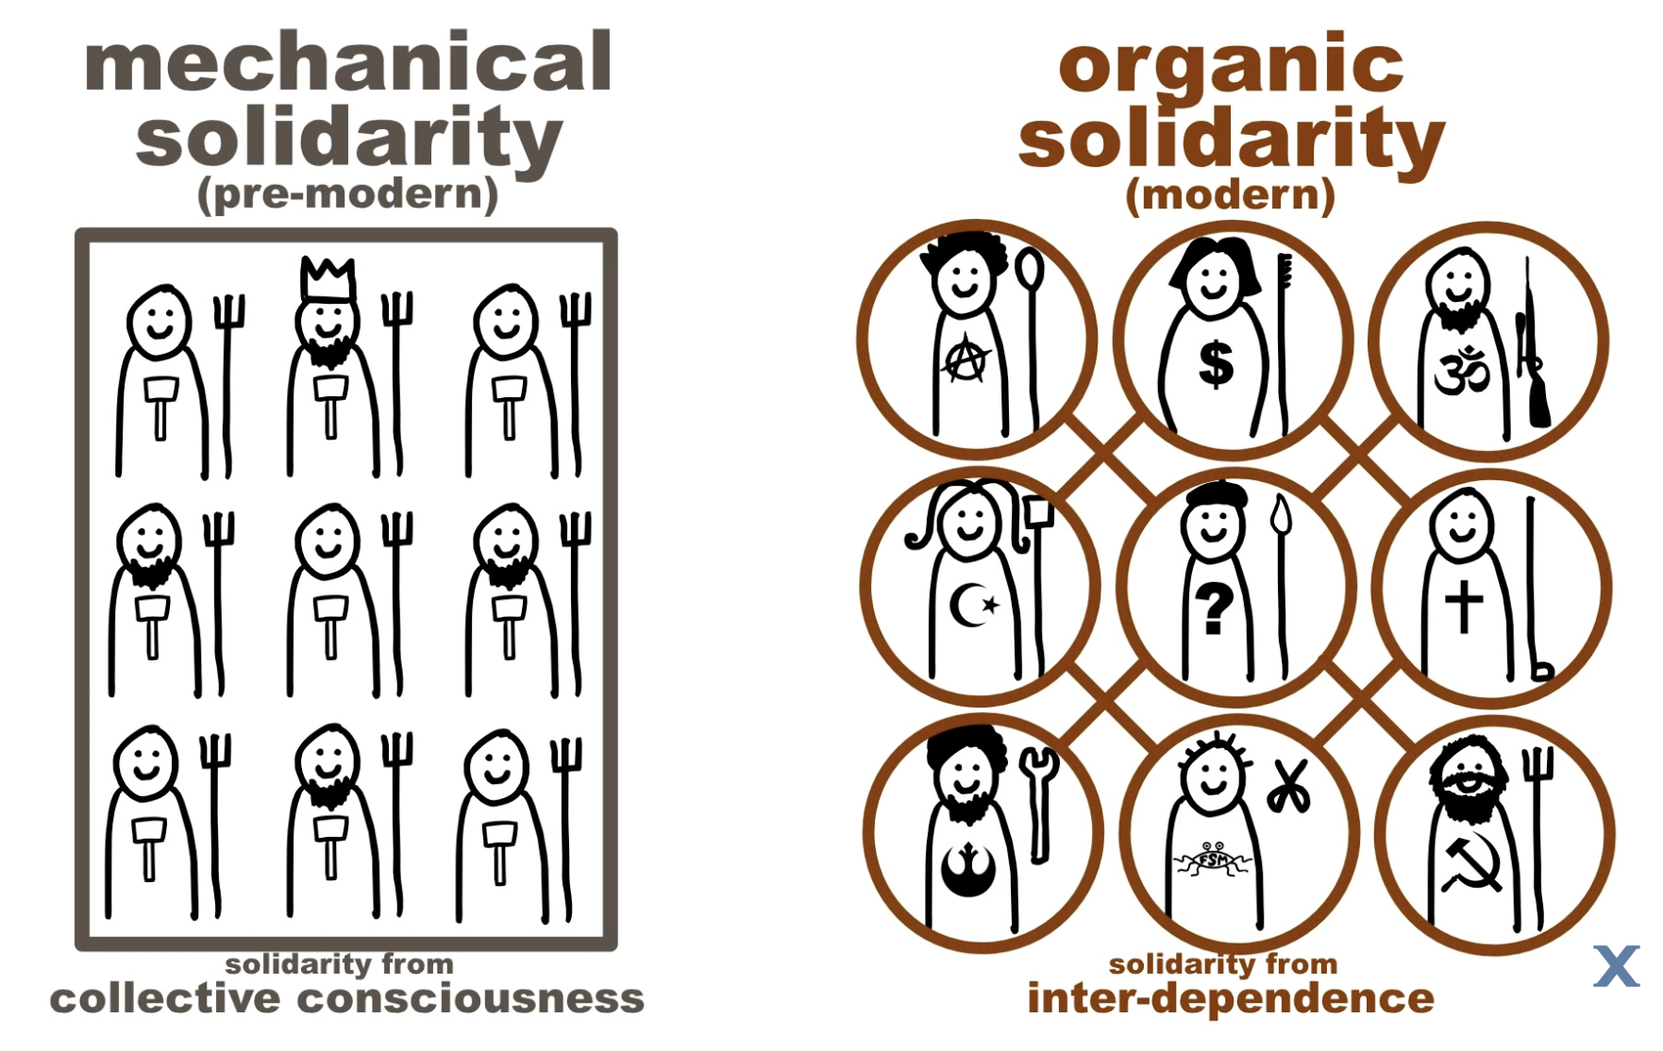
Source:
Alt Shift X

Slide 49
The Division of Labour in Society (1893)
Common Conscience
Social mechanism that holds the group together
Body of beliefs, practices and customary enactments which are held in common by all members of society.
Diffuse throughout the society
Define social purpose
Give meanings to action and structure the pattern of social life
Deriving from the total structure of beliefs that are formed as a result of society (Morrison 1997).

Slide 50
Karl Marx
Born on May 5, 1818 in Their, German Rhineland.
He grew up in a middle class Jewish household and later converted to Protestantism.
Studied in University of Bonn and Berlin.
Worked as a journalist to earn living
Karl Marx (1818-1883)
1845: The German Ideology
1848: Manifesto of the Communist Party
1859: A Contribution to the Critique of Political Economy
1867: Capital. Volume I
1885: Das Kapital, Vol II and 1894: Das Kapital Vol. III (published posthumously)

Slide 51
Historical Materialism/Material Theory of History
Material conditions or economic factors affect the structure and development of society
Marx traced the evolution of human societies from one stage to another.
Interpreted the evolution of societies from the perspective of material or economic bases.
Combination of scientific and revolutionary feature as the hallmark of Marx contribution.
Human history is an account of development and consequences of new forces of material production.
Social relations are defined in terms of material conditions.
Materialism as its starting place (most basic human act). The production of material necessities of food, shelter and clothing (Morrison, 1997).

Slide 52
Historical Materialism
“In the social production of their existence, men inevitably enter into definite relations, which are independent of their will, namely relations of production appropriate to a given stage in the development of their material forces of production. The totality of these relations of production constitutes the economic structure of society, the real foundation, on which arises a legal and political superstructure and to which correspond definite forms of social consciousness. The mode of production of material life conditions the general process of social, political and intellectual life. It is not the consciousness of men that determines their existence, but their social existence that determines their consciousness. At a certain stage of development, the material productive forces of society come into conflict with the existing relations of production or – this merely expresses the same thing in legal terms – with the property relations within the framework of which they have operated hitherto. From forms of development of the productive forces these relations turn into their fetters. Then begins an era of social revolution. The changes in the economic foundation lead sooner or later to the transformation of the whole immense superstructure.” (Marx 1859: Contribution to the critique of political economy).

Slide 53
Core of the Materialist Theory of History
The Means of Production
Refers to anything in the external world which used to obtained livelihood, produce income and acquire material need.
Utilised to produce food, shelter and clothing so as to satisfy human material needs and maintain existence.
Only one class of society always owns the means of production
The Relation of Production
Economically bind one class to another in the production process.
Non-owners of means of production are compelled to enter into relations of production in order to satisfy their material and economic needs

Slide 54
Core of the Materialist Theory of History
The Forces of Production
Refers to the available techniques existing in the means of production including the instruments, equipment, tools and the prevailing means of production themselves.
New productive forces often lead to transition points creating the development of a new mode of production.
The Mode of Production
Asiatic Mode of Production
Ancient Mode of Production
Feudal Mode of Production
Capitalist Mode of Production

Slide 55
Class and Class Structure
“The history of all hitherto existing societies is the history of class struggles.
Freeman and slave, patrician and plebeian, lord and serf, guild-master and journeyman, in a word, oppressor and oppressed, stood in constant opposition to one another, carried on an uninterrupted, now hidden fight, a fight that each time ended either in a revolutionary reconstitution of society at large, or in the common ruin of the contending classes. In the earlier epochs of history, we find almost everywhere a complicated arrangement of society into various orders, a manifold gradation of social rank. In ancient Rome we have patricians, knights, plebeians, slaves; in the Middle Ages, feudal lords, vassals, guild-masters, journeymen, apprentices, serfs; in almost all of these classes, again, subordinate gradations” (Marx, 1848 Communist Manifesto).
.

Slide 56
Theory of Alienation
A state of disruption taking place in the labouring process when workers lose control over their labour and the self defining characteristics of their labouring activity.
Alienation from the product of labour
Alienation from productive activity
Alienation from species activity
Alienation from fellow humans
.

Slide 57
Sample Questions
Max Weber argued that modern-day capitalist attitudes toward work and money have their basis in the religious doctrines of various Protestant sects of Christianity. Discuss this argument.
Religious sphere place its stamp on the formation of economic sphere i.e. capitalism. Discuss this in the light of Max Weber’s work on Protestant ethics and the spirit of capitalism (please do not write more than 300 words-5 marks).
Assertion (A): Economic history alone cannot explain modern society. Reason (R): Other factors like religion, political and legal spheres are equally important to unravel modern industrial society.
Both (A) and (R) are true and (R) is correct explanation of (A)
Both (A) and (R) are true and (R) is not the correct explanation of (A)
(A) is true but (R) is false
Both (A) and (R) are false

Slide 58
All the best for your mid-sem exam
See you all in 2nd half

